Slide 1

The Massey Method & March Madness
An Application of Linear Algebra to Sports Analytics
Notes:
Sports analytics: A broad term the refers to the use of quantitative methods to inform decision making in sports
Quantitative methods can come in a wide variety of forms
This thesis:
explains the concepts of linear algebra behind a quantitative system known as the Massey Method
highlights some modifications and applications of the method
tests the Massey Method’s predictive capabilities in search of the perfect March Madness bracket
Transition: We start with an outline of the method

Slide 2

The Massey Method
A sports rating system that uses past season data and concepts of linear algebra to generate ratings for teams that represent their relative strength
Notes:
Kenneth Massey – undergraduate thesis – Bluefield College – 1997
A sports rating system that uses past season data and concepts of linear algebra to generate ratings for teams that represent their relative strength
Transition: Where do we start? A system of linear equations

Slide 3
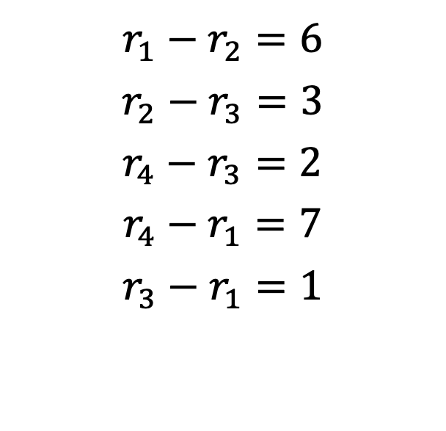
Step 1: A System of Linear Equations
$$r_{1}−r_{2}=6$$
$$r_{2}−r_{3}=3$$
$$r_{4}−r_{3}=2$$
$$r_{4}−r_{1}=7$$
$$r_{3}−r_{1}=1$$
Team 1 beat Team 2 by 6 points
Violates transitivity
Notes:
Each equation represents a game
Variables represent team ratings – dependent on point differential of each game
For example:
r_1 – r_2 = 6 reads – Team 1 beat Team 2 by 6 points
According to this system
Since Team 1 beat Team 2 by 6 points and Team 2 beat Team 3 by 3 points, we would naturally conclude that Team 1 would beat Team 3 by 9 points in a future matchup
However, r_3 - r_1 = 1 is introduced to the system – violating transitivity – natural unpredictability in sports
Transition: How can we easily represent this system?

Slide 4
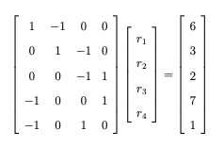
Step 2: A Matrix Representation
An Equivalent Representation in Matrix Form
Notes:
Slide #4: Step 2: A Matrix Representation
An equivalent representation in matrix form
Read off some entries
Transition: The question presents itself; how can we solve the system since it violates transitivity?

Slide 5
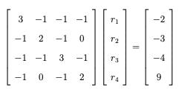

Step 3: Applying Projections
Calculating $M^{T}Mr=M^{T}d$
Too many solutions
Notes:
Slide #5: Step 3: Applying Projections
Instead, we apply a linear algebra concept known as least squares approximation
Finding an approximate solution using projections
Ensure there is a solution
It’s not full rank -> not invertible -> always a null vector (1,1,…,1) -> infinitely many solutions
Transition: How can we ensure a unique solution?

Slide 6
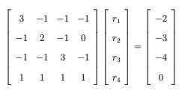
Step 4: The Massey Matrix
Replace final row with 1s
Replace final entry with a 0
Notes:
Massey’s Solution:
Replace final row with 1’s -> full rank -> ensures a unique solution
Replace final entry with a 0 -> centers ratings around 0
Transition: What is the result?

Slide 7
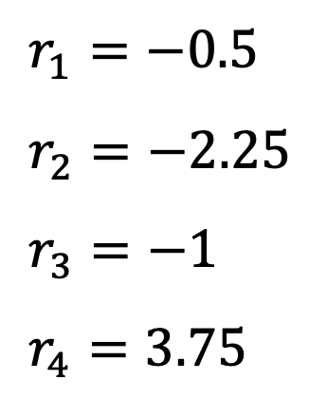
Step 5: Calculate Massey Ratings
$r_{1}=−0.5$
$r_{2}=−2.25$
$r_{3}=−1$
$r_{4}=3.75$
Team 4 expected to beat Team 1 by 3.75-(-0.5) = 4.25 pts
Notes:
Solving the matrix system yields Massey ratings
Representation:
For example: Team 4 would be expected to beat Team 2 by 4.25 pts in a future matchup
Transition: These ratings are helpful in indicating outcomes of future matchups. Is there any way to make them more accurate?

Slide 8
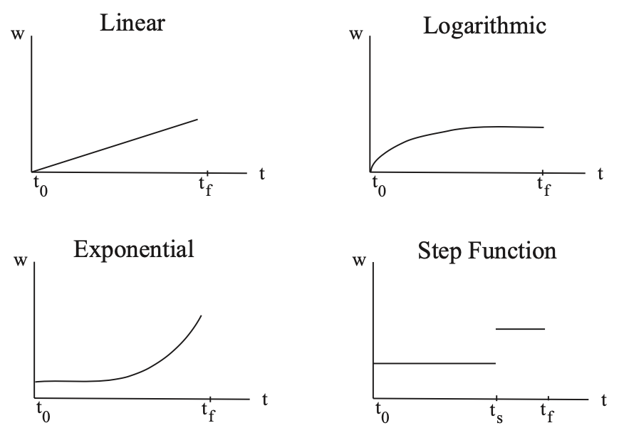
Weighting Schemes
Notes:
Weighting is a systematic process of increasing a particular game’s contribution to a team’s ratings
These can take into account a variety of factors
One common weighting scheme – temporalized weighting
Essentially weighting games based on what time in the season they occur
Are late season games a better indicator of a team’s true strength?
These are examples of a few common temporalized weighting schemes
Describe linear function’s emphasis
Describe step-function’s emphasis
Transition: What are some applications of the Massey Method?

Slide 9


Modern Applications
Bowl Championship Series (1998-2013)
FiveThirtyEight NCAA basketball power ratings
Notes:
Transition: How can we put the Massey Method and weighting schemes into practice?

Slide 10

Project
Create a computer model to generate Massey ratings for NCAA men’s basketball teams
Test the accuracy of Massey ratings in predicting 2024 March Madness outcomes
Compare to ESPN’s Bracket Challenge
Notes:
Create a computer model to generate Massey ratings for NCAA men’s basketball teams
Test the accuracy of Massey ratings in predicting 2024 March Madness outcomes
Compare to ESPN’s Bracket Challenge
Transition: Where did the project start?

Slide 11
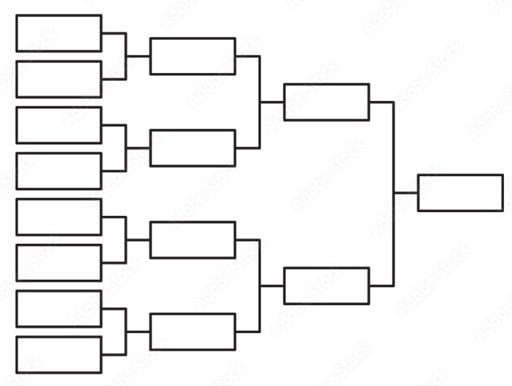
Filling Out Brackets
Outcome predictions based on which team has the higher Massey rating
Separate brackets created for each Massey weighting scheme
Points added up according to ESPN’s tournament challenge
Notes:
Built a Python program to import data, populate matrix entries, perform matrix operations, and output results
Outcome predictions based on which team has the higher Massey rating
Separate brackets created for each Massey weighting scheme – to see how they would perform
Points added up according to ESPN’s tournament challenge
Transition: What were the results?

Slide 12

Results
Rating Method | Raw Score (ESPN) | Percentile
Linear | 1220 pts | 93rd
Bi-Weekly Step | 1220 pts | 93rd
Logarithmic | 1210 pts | 91st
Exponential | 920 pts | 72nd
Unweighted | 770 pts | 61st
Notes:
According to ESPN’s tournament challenge
Linear – 1220 pts – 93rd per
Bi-Weekly Step – 1220 pts – 93rd per
These performed the highest
With the other weighted and unweighted methods following
Insights: 50th percentile = 670 pts top bracket = 1810 pts
Linear and Bi-Weekly step would have ranked 6th out of 83 brackets submitted to Christendom’s bracket challenge in 2024

Slide 13
Conclusion
Massey ratings have predictive capabilities
Opportunities to increase the accuracy of the model
“If you challenge conventional wisdom, you will find ways to do things much better than they are currently done.” –Michael Lewis, Moneyball
Notes:
Massey ratings have clear predictive capabilities
However, there are always opportunities to increase the accuracy of the model
Factors: Home field advantage, strength of schedule, player injury
“If you challenge conventional wisdom, you will find ways to do things much better than they are currently done.” -Michael Lewis, Moneyball

